Slide 1
SPOTIFY ANALYSIS PROJECT

Slide 2
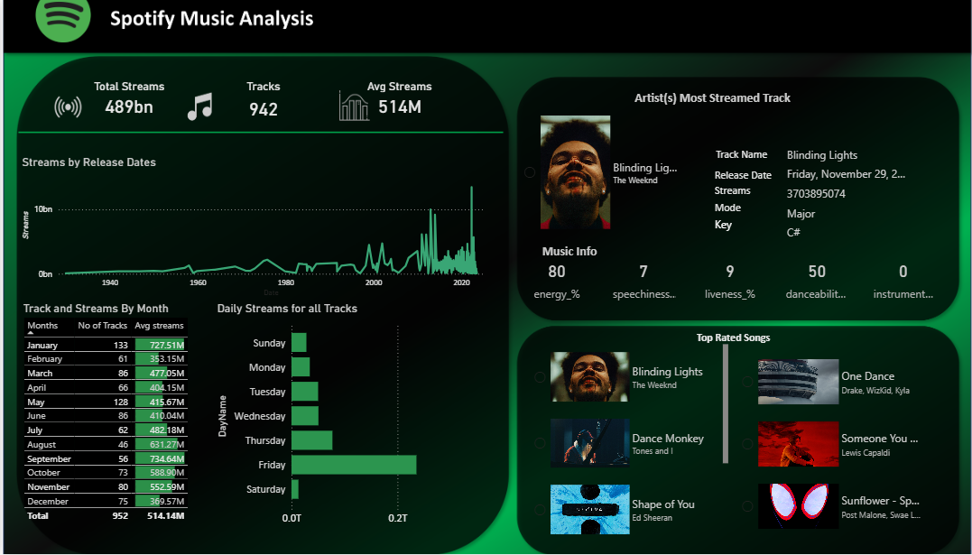

Slide 3
PROJECT OVERVIEW
Release Timing: Peak streams on Fridays and weekends suggest that aligning music releases with these days maximizes exposure and user engagement.
Release Timing: Peak streams on Fridays and weekends suggest that aligning music releases with these days maximizes exposure and user engagement.
Data-Driven Curation: Popular audio features (energy, danceability) and artists' recurring success show that Spotify’s algorithms are highly attuned to listener preferences and actively shape consumption patterns.

Slide 4
KEY METRICS OVERVIEW
Interpretation: The dashboard shows a total of 489 billion streams across 942 tracks, with an average of 514 million streams per track. This indicates an extremely high engagement level for the dataset; most likely, it focuses on Spotify's most popular tracks globally.
Implication: Such high averages reveal strong user concentration on a subset of highly popular songs, which aligns with the power-law distribution (hits-driven market) observed in streaming platforms

Slide 5
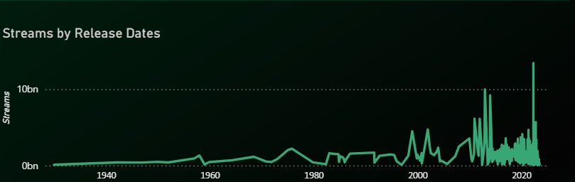
STREAMING TRENDS OVER TIME
Streams by Release Dates
Interpretation: The line chart displays a timeline from the early 1940s to the present, with noticeably low streaming activity in early years and major spikes after 2000, peaking dramatically in recent years.
Implication: This trend highlights how streaming is predominantly driven by recent releases, with older tracks rarely matching the volume of new music. The rapid increase after 2010 matches Spotify’s expansion and the global adoption of streaming as the primary mode of music consumption

Slide 6
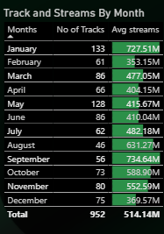
MONTHLY PERFORMANCE BREAKDOWN
Interpretation:
January shows the highest average streams (727.51M) with 133 tracks, while December has the lowest (369.57M) over 75 tracks.
August, October, and March also have notably high averages.
Implication: The higher activity in January could reflect renewed listening habits post-New Year celebrations, playlist updates, and new music releases. Lower December averages might result from users shifting focus during year-end holidays or less music released during this period. These patterns can inform release strategies for artists and marketers.​

Slide 7
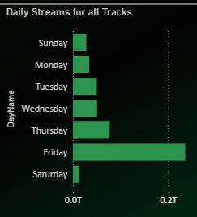
WEEKLY LISTENING PATTERNS
Interpretation:
The bar chart for daily streams reveals that Friday and Saturday see the highest streaming volumes, with Friday being the clear leader. Sunday and Monday are the lowest.
Implication:
This reflects global patterns: Friday is the standard release day for new music, causing a spike in interest. The weekend effect is visible with Saturday follow-through, and weekday listenership decreases as people return to routine activities. Platforms, artists, and advertisers can leverage this for release and campaign timing.​

Slide 8
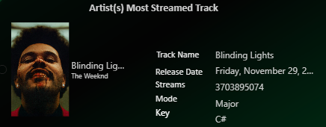
TOP ARTIST AND MOST STREAMED TRACK
Interpretation: "Blinding Lights" by The Weeknd stands out as the top track, with over 3.7 billion streams. Key musical features: high energy (80%), moderate danceability (50%), and minimal instrumentalness—attributes aligning with mainstream pop success.
Implication: These characteristics (energy, moderate danceability, vocal-driven) are common in highly-streamed global hits, suggesting a formulaic element in track popularity. The dominance of "Blinding Lights" also reflects its cross-audience appeal and strong playlist placements.

Slide 9

AUDIO FEATURE PROFILE
Interpretation:
High energy & fairly high danceability match upbeat, accessible radio hits.
Low instrumentalness and speechiness reinforce accessibility and mass appeal.
Implication: Such audio profiles are common among “popular music” on streaming platforms. Recommender algorithms may amplify tracks with similar profiles, which in turn shapes listening trends and user preferences.

Slide 10
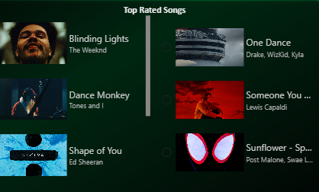
GLOBAL TOP RATED SONGS
Interpretation: Other highly-streamed tracks fit similar profiles – “One Dance” (Drake), “Dance Monkey” (Tones and I), “Shape of You” (Ed Sheeran), “Someone You Loved” (Lewis Capaldi), and “Sunflower” (Post Malone, Swae Lee).
Implication: These songs highlight the effectiveness of collaborative filtering and personalized recommendations, as Spotify’s ML algorithms surface tracks trending globally but tuned to individual tastes. Cross-genre hits with high energy and catchy hooks dominate.

